Slide 1
Cyclistic Bike
how does a bike-share navigate a speedy success
Date: 17 Nov 2021

Slide 2
Overview
Description
Design a marketing strategy aiming to convert casual riders into annual members. In order to maximize the benefit of this marketing strategy, we will need to explore 3 main topics:
How do members differ in behavior from casual riders
Why would casual riders buy an annual subscription
How can Cyclistic Bike as a company use digital media to influence casual riders.
Task
In this presentation, we will focus more on the first topic analyzing the different behaviors between member and casual riders.

Slide 3
Data info.
Information on the Data Used
This case study sheds the light on the different behaviors between members and casual users by analyzing data that have the following characteristics:
Data records of bike trips in the past year have been used, the data is split in 4 files, 1 for each quarter.
The data used has been made available by Motivate International Inc. under this license.
Data are stored in a shared folder where only members of the working team are granted access.

Slide 4
Data Manipulation
A total of 3,879,822 bike trips have been analyzed. 4 files aggregated into 1 file and few data manipulation have been applied to ensure data consistency:
R Programming has been used as it is the most efficient tool for this size of data and the required manipulation
Column names have been unified between the 4 files.
Added few columns showing the trip duration and day of week, Month and year
Removed lines with negative trip duration (bike maintenance trips to HQ).
Unified subscription type (subscriber & member = member, casual & customer = casual) , the total split of trips between casual & member rides as follows:
Subscription type | Trips_counts
Casual | 48,480
Customer | 857,474
member | 378,407
Subscriber | 2,595,461
Total | 3,879,822
Subscription type | Trips_counts
casual | 2,973,868
member | 905,954
Total | 3,879,822

Slide 5
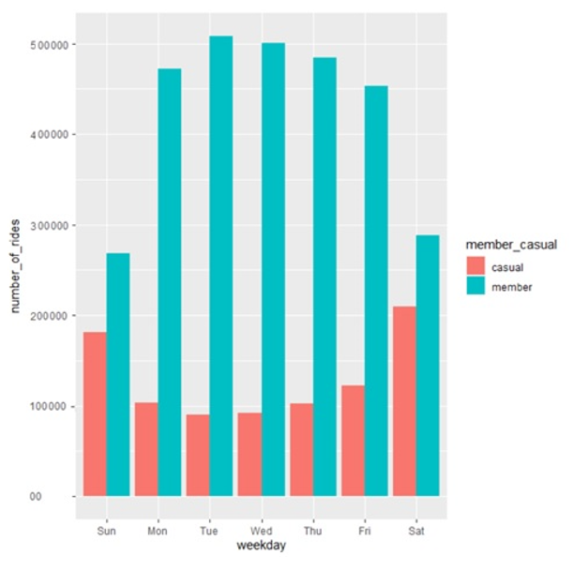
Data Analysis Total Number of Rides per weekday per type of subscription
Members: number of rides significantly increases in working days among members while decreases in weekend.
Casual: The opposite for casual riders, number of rides almost doubles in weekends while decreases during working days.
Total number of rides among members higher than total number of trips among casual riders.

Slide 6
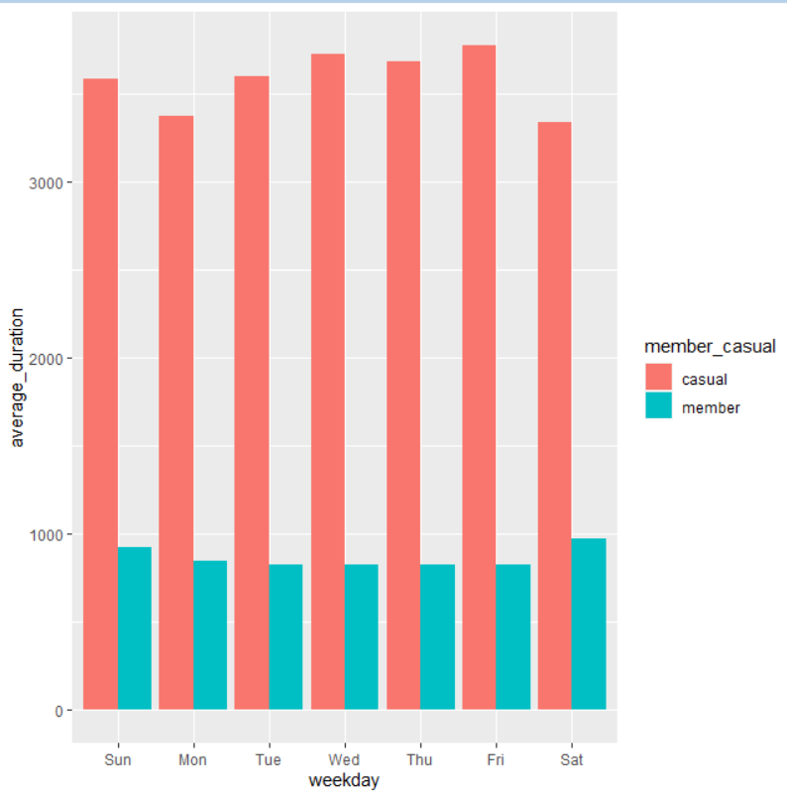
Data Analysis Total average duration of rides per weekday per type of subscription
Members & Casual: average duration of rides does not notably change in different weekdays but is clear that the average ride duration among members is lower than that of the casual riders.

Slide 7
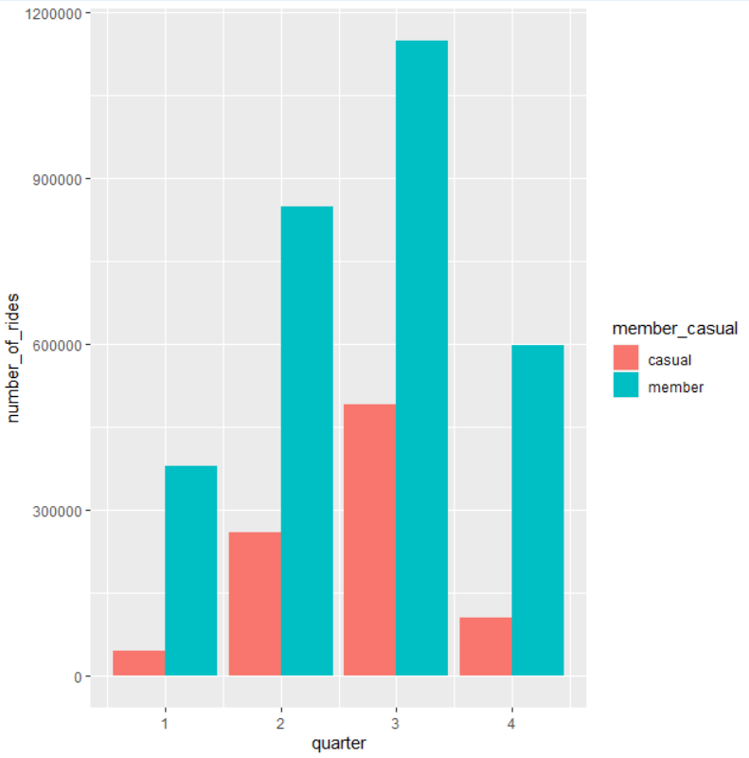
Data Analysis Total Number of Rides per quarter per type of subscription
Members & Casual: total number of rides increases in summer (quarter 2 & 3) while decreases in quarters 4 and 1. Q3 shows highest number of rides, Q1 shows lowest number of rides.

Slide 8
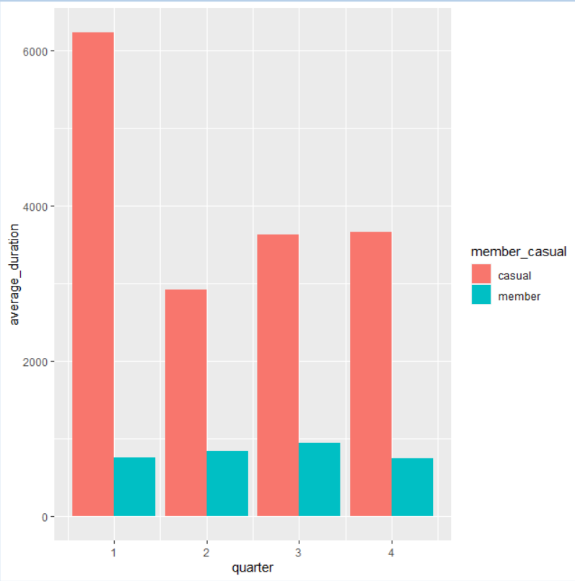
Data Analysis Total average duration of rides per quarter per type of subscription
Members & Casual: average duration of rides does not notably change in different quarters.
Casual: average duration of rides is notably higher in first quarter, but this could be an outlier as we have less rides recorded among casual riders in Quarter 1.

Slide 9
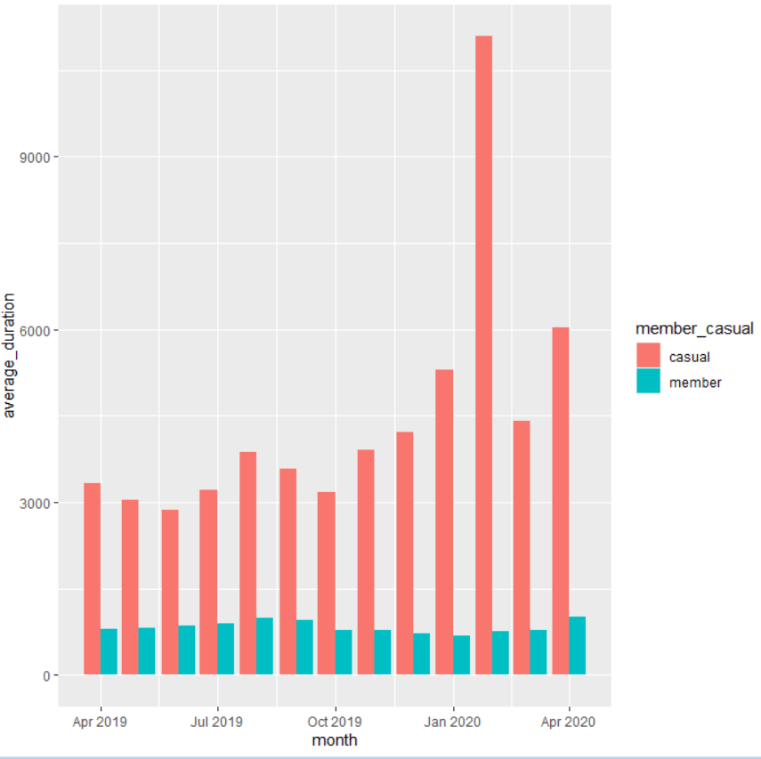
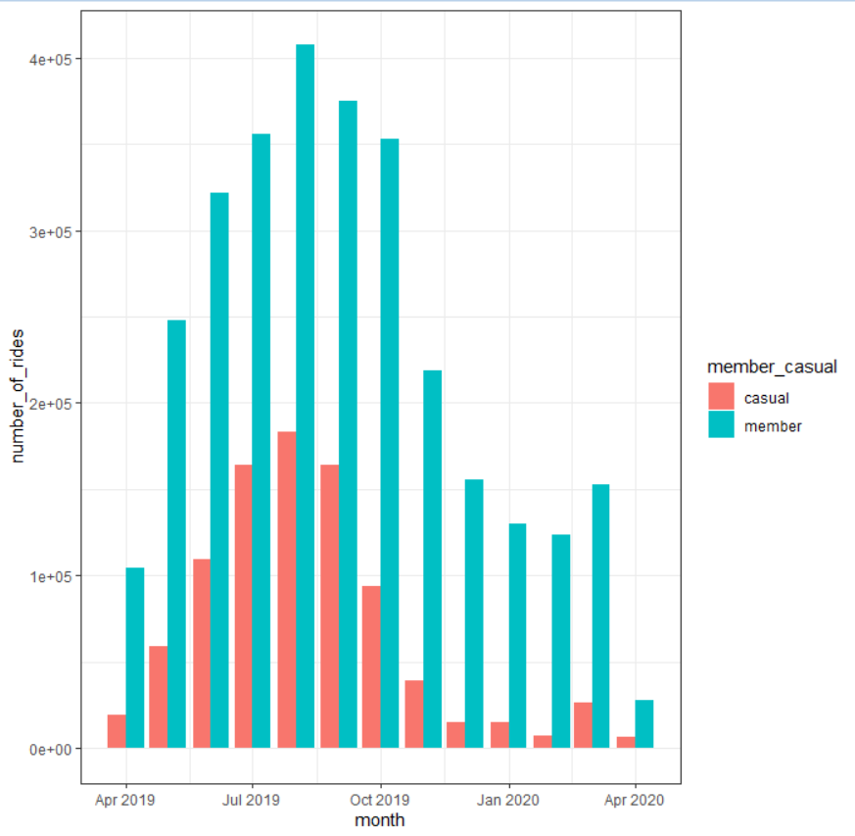
Data Analysis Total Rides & Avg duration of rides per month per rider type
Highest number of rides are recorded in the months of July, Aug & Sept for both members and casual riders. Number of member rides are higher in all months.
Average duration is higher among casual riders but almost similar in all months. February shows higher average duration for Casual riders but that could be due to much lower number of rides in this month.

Slide 10
Summary and Recommendations
The number of rides among members are more during working days and less during weekend, while it is the opposite for the casual riders. It is also noted that the number of rides among casual and member riders increase in the period between April and September (hotter months) while decrease from Oct to March.
Average trip duration is generally much longer among casual riders than that of the members.
In converting the casual riders into members, it is recommended to take in consideration the following in the marketing campaign:
Intensify the marketing campaign addressing casual riders during weekdays as those are possibly among the riders that use the bike for a similar purpose as member riders.
Extensive marketing campaign addressing casual riders from April to September, as those months records significantly higher number of riders

Slide 11
Suggestions & Next steps
Modify the mobile app to record more accurate data on location of start and end of the trips
Maintenance trips should not be recorded in the dataset to be used next time for analysis as this was causing misleading info.
Next Steps for a better analysis if given the time to do it:
Compare the number of trips per month with weather conditions
Compare the number of trips per month with number of tourists
Identify Trips where both casual and member riders use the same start and end stations as in this analysis I focused more on the highest significant trip.

Slide 12
Question & answer

